Slide 1
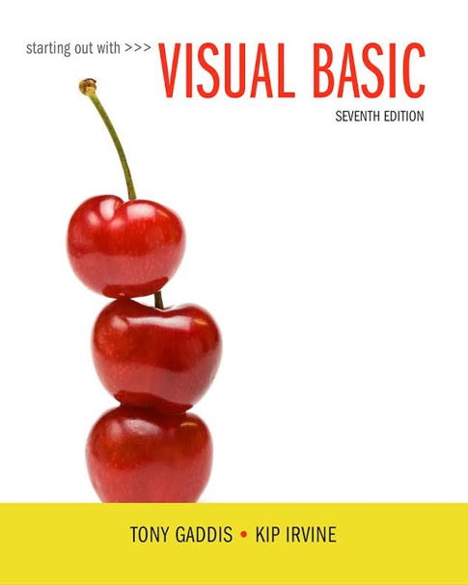
Starting out with Visual Basic®
Seventh Edition
Chapter 8
Arrays and More
Copyright © 2017, 2014, 2011 Pearson Education, Inc. All Rights Reserved
Notes:
If this PowerPoint presentation contains mathematical equations, you may need to check that your computer has the following installed:
1) MathType Plugin
2) Math Player (free versions available)
3) NVDA Reader (free versions available)

Slide 2
Learning Objectives
8.1 Arrays
8.2 Array Processing Techniques
8.3 Procedures and Functions That Work with Arrays
8.4 Multidimensional Arrays
8.5 Focus on G U I Design: The Enabled Property and the Timer Control
8.6 Focus on G U I Design: Anchoring and Docking Controls
8.7 Focus on Problem Solving: Building the Demetris Leadership Center Application
8.8 Using Lists to Hold Information (Optional Topic)

Slide 3
Introduction (1 of 2)
Arrays are like groups of variables that allow you to store sets of similar data
A single dimension array is useful for storing and working with a single set of data
A multidimensional array can be used to store and work with multiple sets of data

Slide 4
Introduction (2 of 2)
Array programming techniques covered
Summing and averaging all the elements in an array
Summing all the columns in a two-dimensional array
Searching an array for a specific value
Using parallel arrays

Slide 5
8.1 Arrays

Slide 6
Array Characteristics
An array stores multiple values of same type
Like a group of variables with a single name
For example, the days of the week might be:
A set of 7 string variables
With a maximum length of 9 characters
All variables within an array are called elements and must be of the same data type
You access the elements in an array through a subscript

Slide 7
Subscript Characteristics
A subscript, also called an index, is a number that identifies a specific element within an array
Subscript numbering works like a list box index:
Subscript numbering begins at 0
1st element in an array is always subscript 0
Last element is total number of elements − 1
An array with 7 elements refers to the 1st element as subscript 0 and the last element as subscript 6

Slide 8
Declaring an Array
Declare an array much like a regular variable
ArrayName is the name of the array
UpperSubscript is the value of the array’s highest subscript
Must be a positive Integer
Positive Integer named constant
Integer variable containing a positive number
DataType is a Visual Basic data type

Slide 9
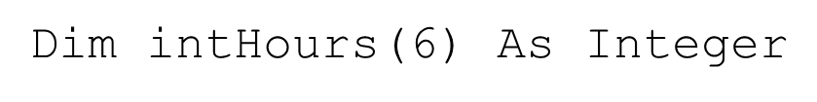
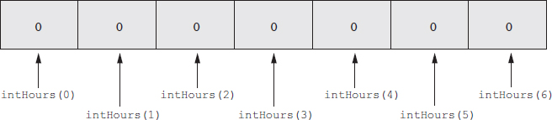
Array Declaration Example
This statement declares i n t Hours as an array of Integers
(6) indicates that the array’s highest subscript is 6
Consists of seven elements with subscripts 0 through 6
Array elements are initialized to 0

Slide 10
Default Initialization
All elements of an Integer array are initialized to zero
Same initialization as an integer variable
Each array element is initialized exactly the same as a simple variable of that data type
Decimal elements are initialized to zero (0.0)
String elements are initialized to the special value Nothing

Slide 11
Implicit Array Sizing and Initialization
An array can be initialized when declared
Example:
This array is implicitly sized
Upper subscript value is left blank
Number of elements implied from initialization
Upper subscript of 5 implied by this example
This results in a 6 element array
Elements are assigned the values shown

Slide 12
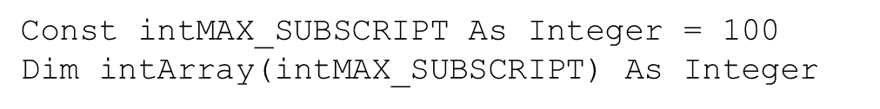
Using Named Constants as Subscripts in Array Declarations
A named constant may be used as an array’s highest subscript instead of a number
This is a common use for named constants
Highest subscript is often used multiple times
If highest subscript changes, use of a named constant allows it to be changed in one place

Slide 13
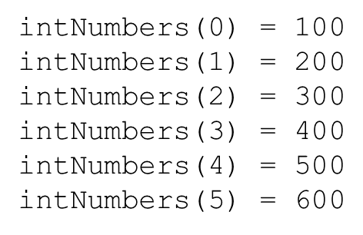
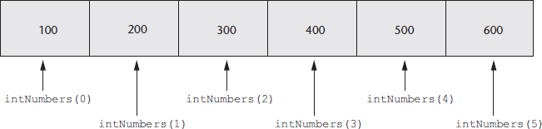
Working with Array Elements
You can store a value in an array element with an assignment statement

Slide 14
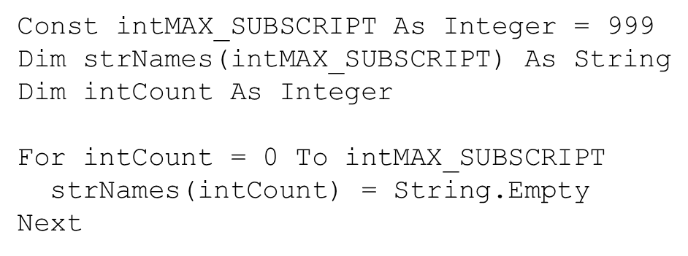
Accessing Array Elements with a Loop
Loops are frequently used to process arrays
Using an Integer variable as a subscript
For example, the following code stores an empty string in each element of s t r Names, a 1000-element array of strings:

Slide 15
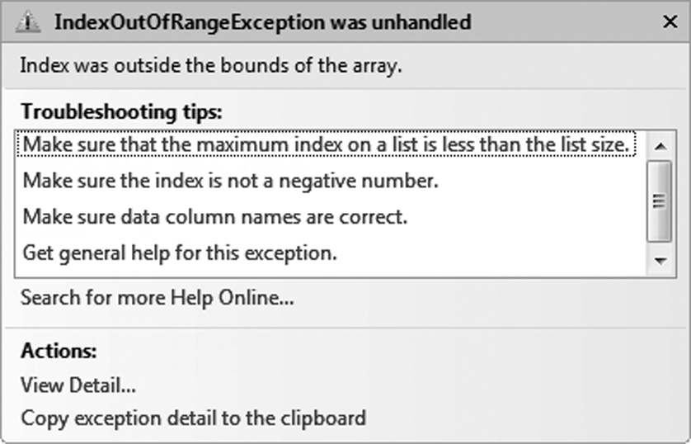
Array Bounds Checking
The Visual Basic runtime system performs array bounds checking
It does not allow a statement to use a subscript outside the range of valid subscripts for an array
An invalid subscript causes V B to throw a run-time exception
Bounds checking is not done at design time

Slide 16
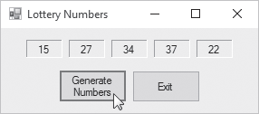
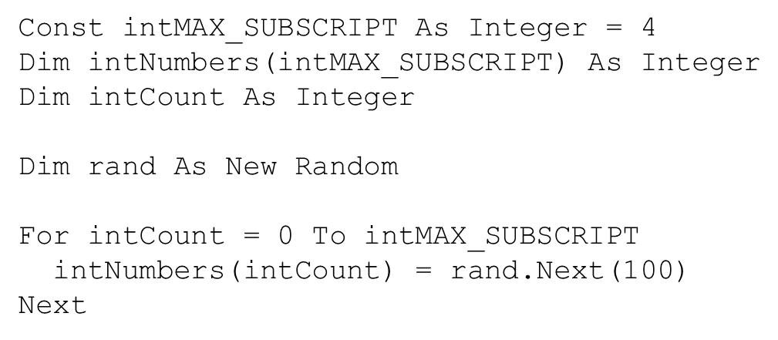
Using an Array to Hold a List of Random Numbers
In Tutorial 8-1 you will create an application that randomly generates lottery numbers

Slide 17
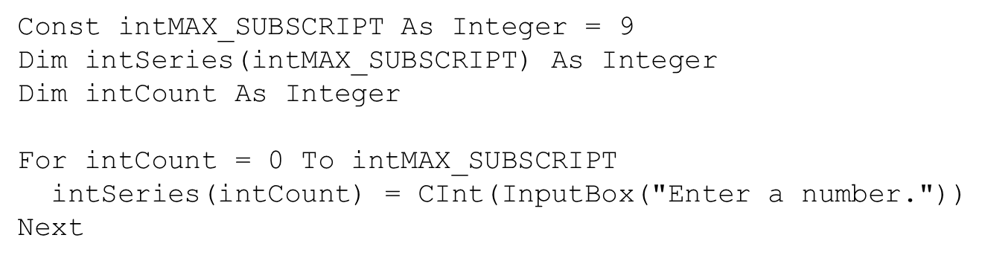
Using Array Elements to Store Input
Array elements can hold data entered by the user
In Tutorial 8-2 you will create an application that
Uses input boxes to read a sequence of strings as input
Stores those strings in an array

Slide 18
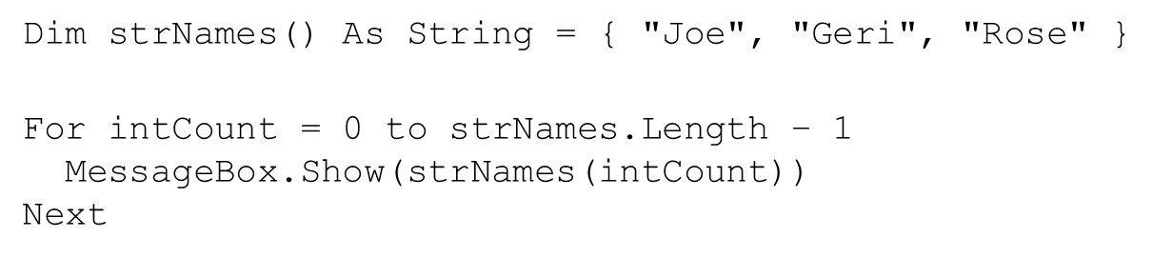
Getting the Length of an Array
Arrays have a Length property
Holds the number of elements in the array
For example
s t r Names.Length − 1 as the loop’s upper limit
Length property is 1 greater than the upper subscript

Slide 19

Processing Array Contents
Array elements can be used just like regular variables in operations
For example
Multiplication
Addition
Format String
In Tutorial 8-3 you will complete an application that performs calculations using array elements

Slide 20
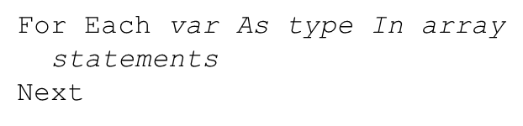
Accessing Array Elements with a For Each Loop (1 of 2)
The For Each loop can simplify array processing
Retrieves the value of each element
Cannot modify values
Here is the general format:
V a r is the name of a variable just for use with the loop
type is the data type of the array
array is the name of an array

Slide 21
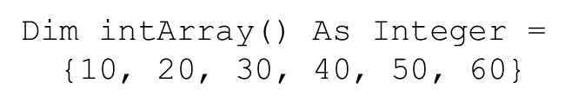
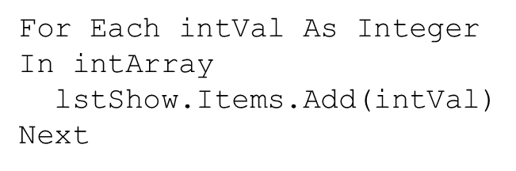
Accessing Array Elements with a For Each Loop (2 of 2)
For example, suppose we have the following array declaration:
The following For Each loop displays all the values in a list box named l s t Show:

Slide 22
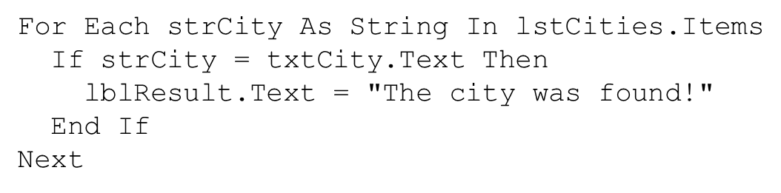
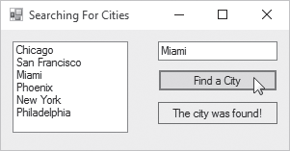
Optional Topic: Using the For Each Loop with a ListBox
A For Each loop can also be used to process items in a collection
For example, to search for a city name in the Items collection of a ListBox control named l s t Cities

Slide 23
8.2 Array Processing Techniques

Slide 24
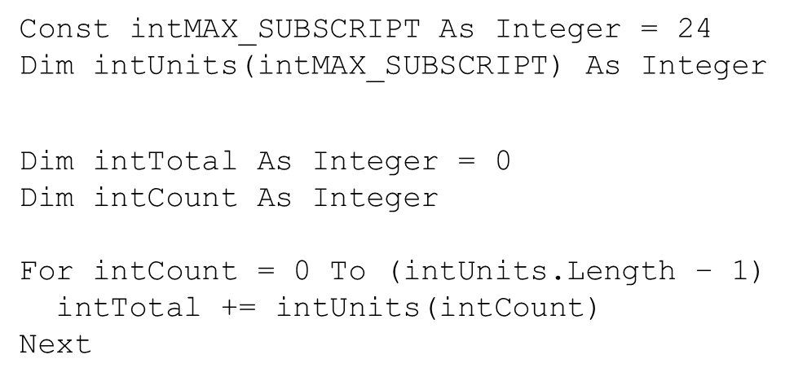
How to Total the Values in a Numeric Array (1 of 2)
To total the values in a numeric array
Use a loop with an accumulator variable
A For…Next loop for example:

Slide 25
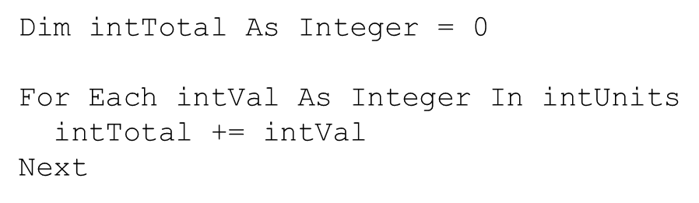
How to Total the Values in a Numeric Array (2 of 2)
You can also use a For Each loop with an accumulator variable
After the loop finishes
i n t Total will contain the total of all the elements in i n t Units

Slide 26
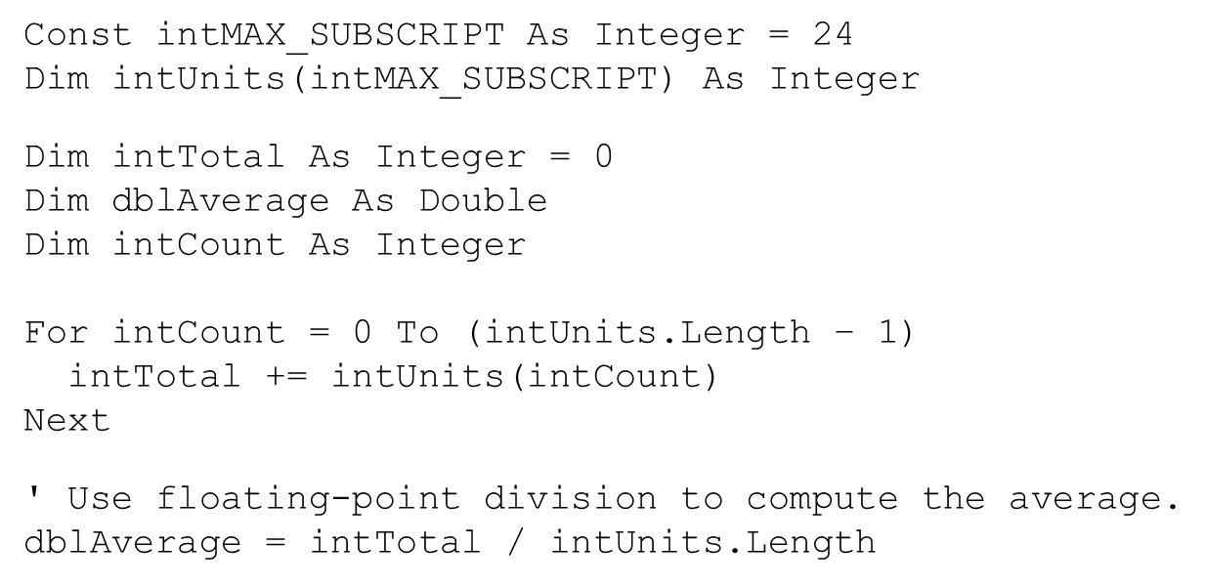
Calculating the Average Value in a Numeric Array
Sum the values in the array
Divide the sum by the number of elements

Slide 27
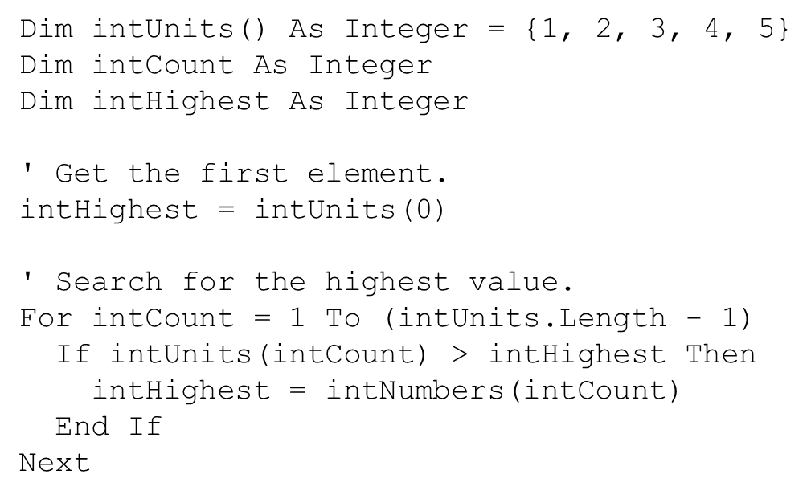
Find the Highest and Lowest Values in an Integer Array (1 of 2)
Highest Value

Slide 28
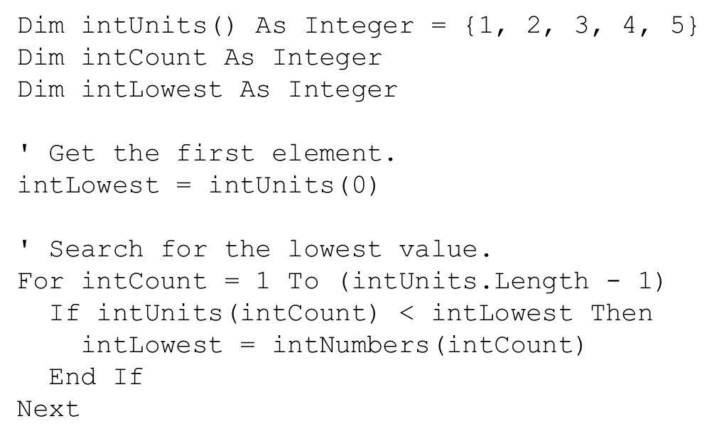
Find the Highest and Lowest Values in an Integer Array (2 of 2)
Lowest Value

Slide 29

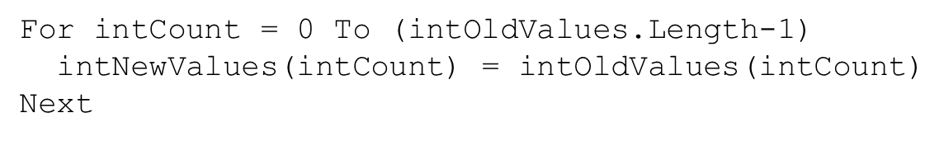
Copying One Array’s Contents to Another
A single assignment statement
Does not copy array values into another array
Causes both array names to reference the same array in memory
A loop must be used to copy individual elements from one array to another

Slide 30
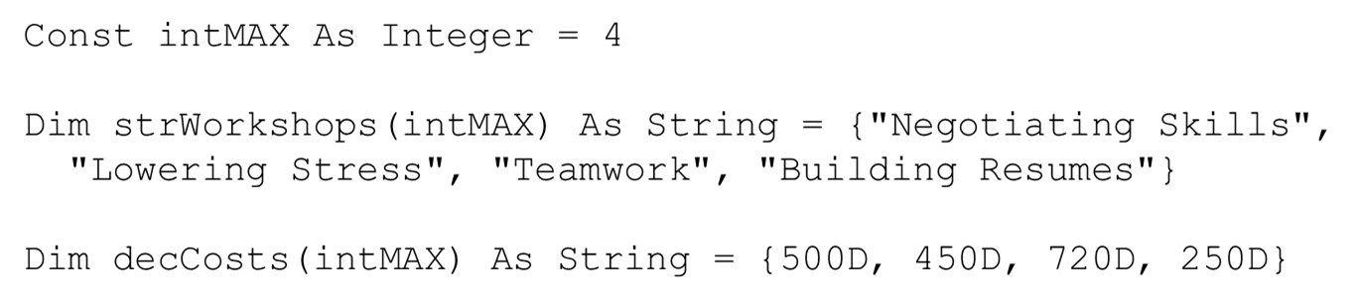
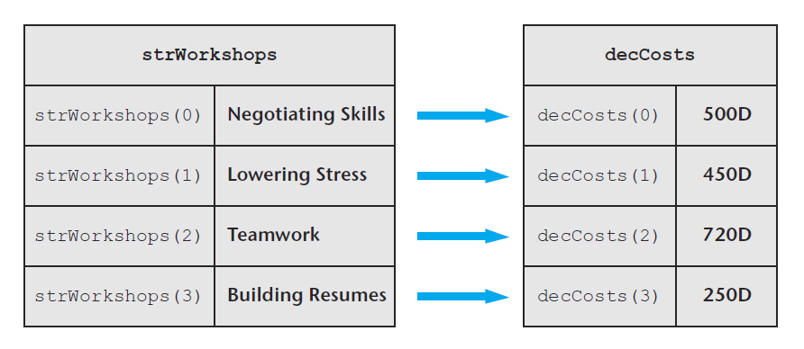
Parallel Arrays
Related data in multiple arrays can be accessed using the same subscript
Tutorial 8-4 examines an application that uses parallel arrays

Slide 31
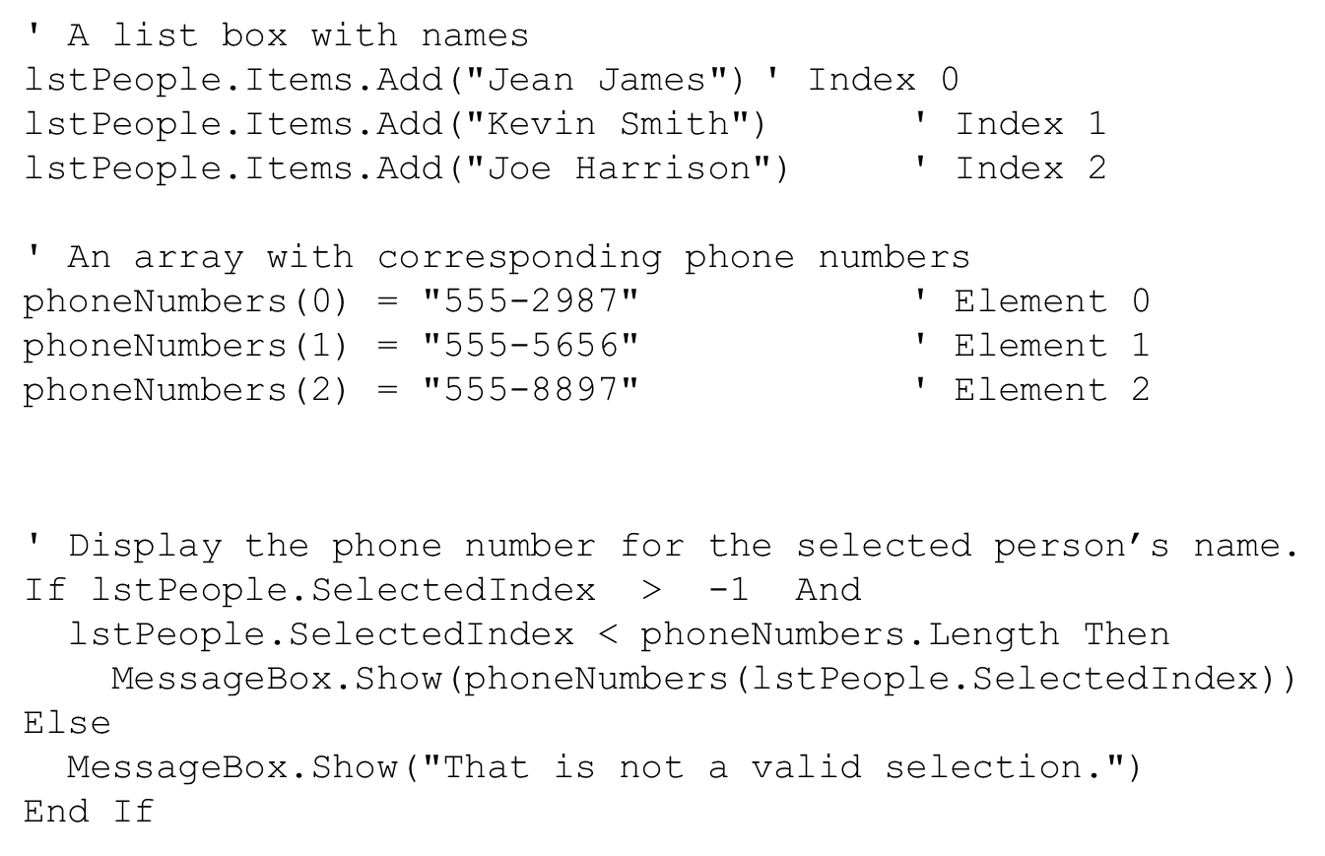
Parallel Relationships Between Arrays, List Boxes, and Combo Boxes

Slide 32
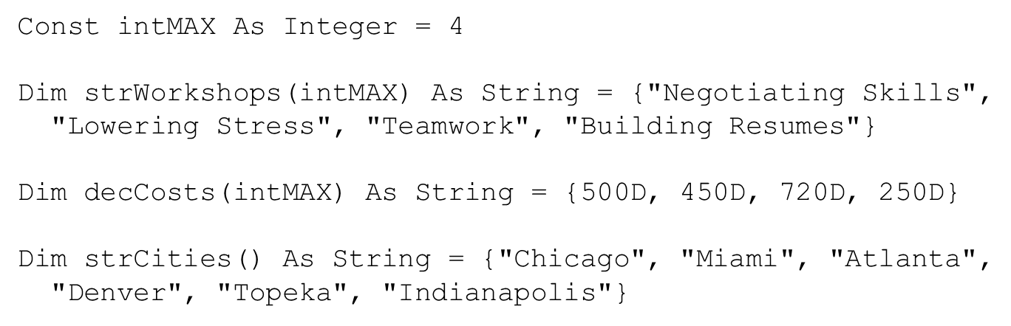
Arrays That Point to Other Data (1 of 2)
Arrays can be useful when you need to look up information in another array that has its data in a different order
To match up the data in s t r Workshops to s t r Cities, we create a location array that tells us where each workshop is located:

Slide 33
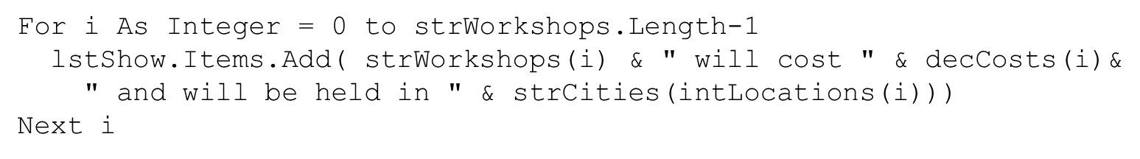
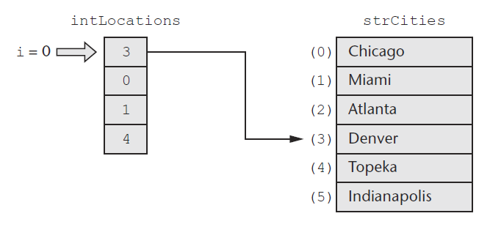
Arrays That Point to Other Data (2 of 2)
In the loop, when i = 0:
i n t Locations(0) contains the value 3
3 is used as the subscript for s t r Cities
The element in the s t r Cities(3) is “Denver”

Slide 34
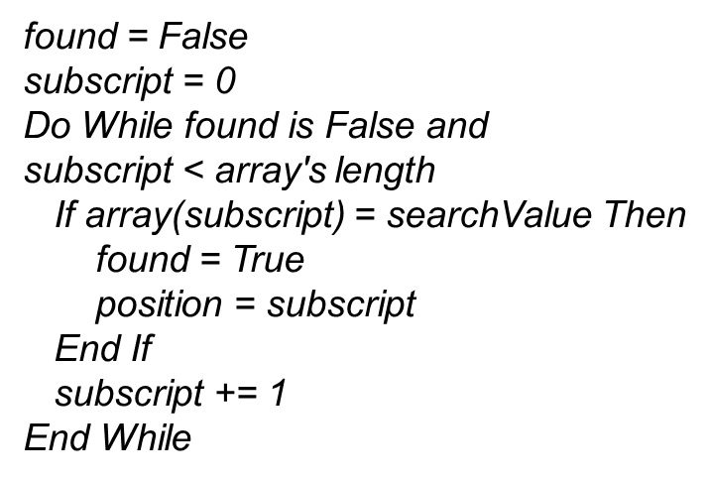
Searching Arrays
The most basic method of searching an array is the sequential search
Uses a loop to examine elements in the array
Compares each element with the search value
Stops when the value is found or the end of the array is reached
The Pseudocode for a sequential search is as follows:

Slide 35

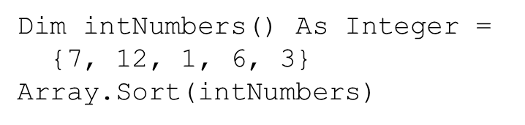
Sorting an Array (1 of 2)
Programmers often want to sort, or arrange the elements of an array in ascending order
Values are arranged from lowest to highest
Lowest value is stored in the first element
Highest value is stored in the last element
To sort an array in ascending order
Use the Array.Sort method
Here is the general format:
ArrayName is the name of the array you want to sort
For example:
After the statement executes, the array values are in the following order
1, 3, 6, 7, 12

Slide 36
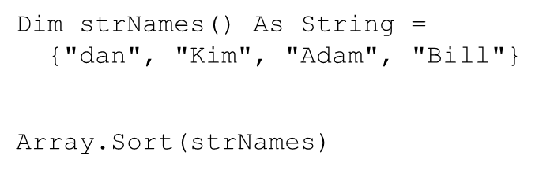
Sorting an Array (2 of 2)
When you pass an array of strings to the Array.Sort method the array is sorted in ascending order
According to the Unicode encoding scheme
Sort occurs in alphabetic order
Numeric digits first
Uppercase letters second
Lowercase letters last
For example:
After the statement executes, the values in the array appear in this order:
“Adam”, “Bill”, “Kim”, “dan”

Slide 37
Dynamically Sizing Arrays
You can change the number of elements in an array at runtime, using the R e D i m statement
Preserve is optional
If used, the existing values of the array are preserved
If not, the existing values are destroyed
Arrayname is the name of the array being resized
UpperSubscript is the new upper subscript
Must be a positive whole number
If smaller that it was, elements at the end are lost

Slide 38

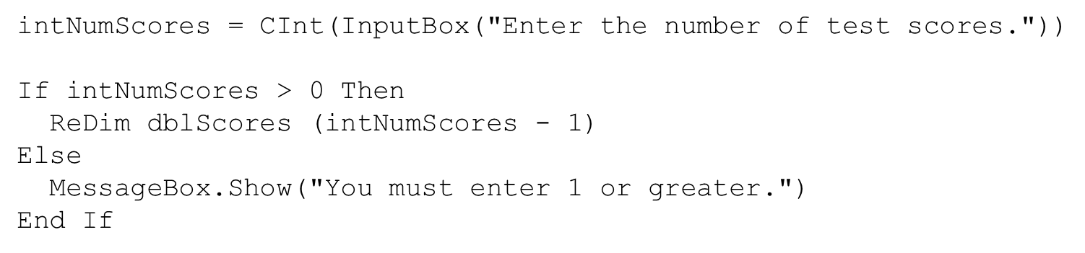
Dynamically Sizing Arrays Example
You can initially declare an array with no size, as follows:
Then prompt the user for the number of elements
And resize the array based on user input

Slide 39
8.3 Procedures and Functions That Work with Arrays

Slide 40
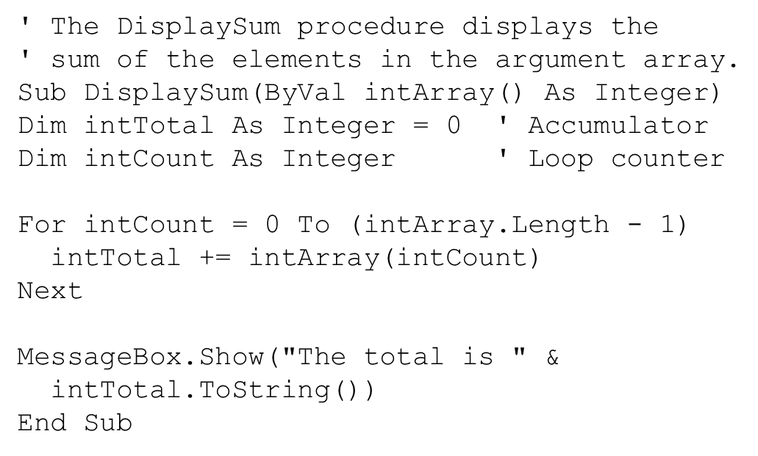
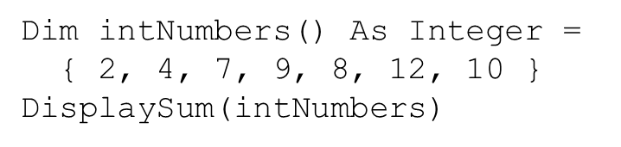
Passing Arrays as Arguments
Procedures can be written to process the data in arrays
Store data in an array
Display an array’s contents
Sum or average the values in an array
Usually such procedures accept an array as an argument
Pass the name of the array as the argument to the procedure or function

Slide 41
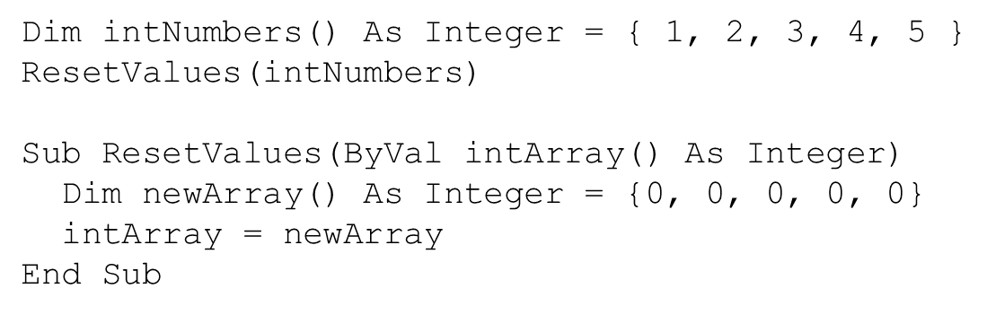
Passing Arrays by Value and by Reference (1 of 2)
Array arguments can be accessed and modified if passed By Val or By Ref
By Val prevents an array from being assigned to another array
By Ref allows an array to be assigned to another array

Slide 42
Passing Arrays by Value and by Reference (2 of 2)
After the ResetValues procedure executes
If passed By Val
i n t Numbers is unchanged and keeps the values {1, 2, 3, 4, 5}
If passed By Ref
i n t Numbers will reference the newArray values {0, 0, 0, 0, 0}

Slide 43
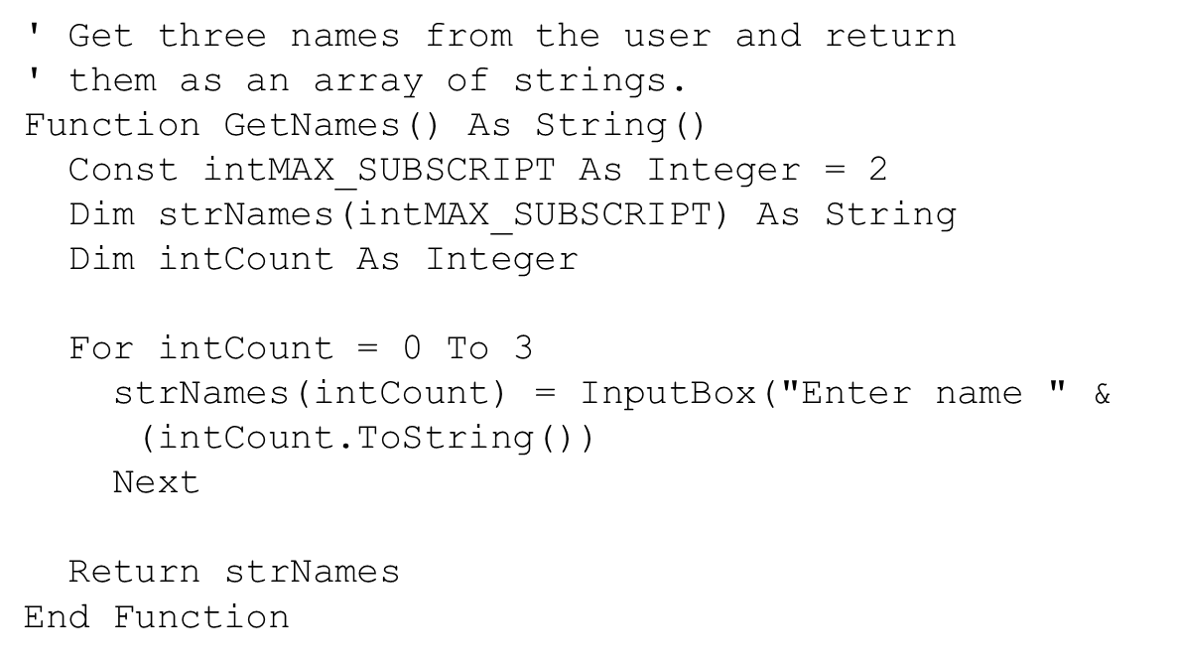
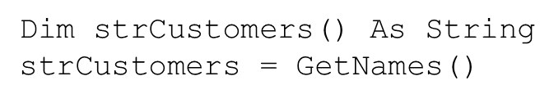
Returning an Array from a Function
Tutorial 8-5 demonstrates passing an array to procedures and functions

Slide 44
8.4 Multidimensional Arrays

Slide 45
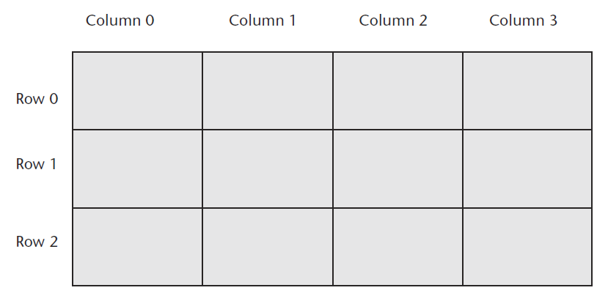
Two-Dimensional Arrays
An array with one subscript is called a one-dimensional array
Useful for storing and working with a single set of data
A two-dimensional array is like an array of arrays
Used to hold multiple sets of values
Think of it as having rows and columns of elements

Slide 46

Declaring a Two-Dimensional Array
A two-dimensional array declaration requires two sets of upper subscripts
First upper subscript is for the rows
Second upper subscript for the columns
ArrayName is the name of the array
UpperRow is the value of the highest row subscript
Must be a positive integer
UpperColumn is the value of the highest column subscript
Must be a positive integer
DataType is the Visual Basic data type
Example declaration with three rows and four columns:

Slide 47
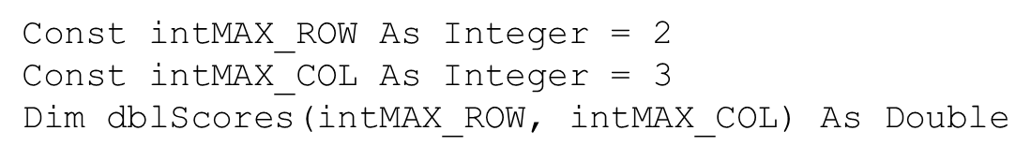
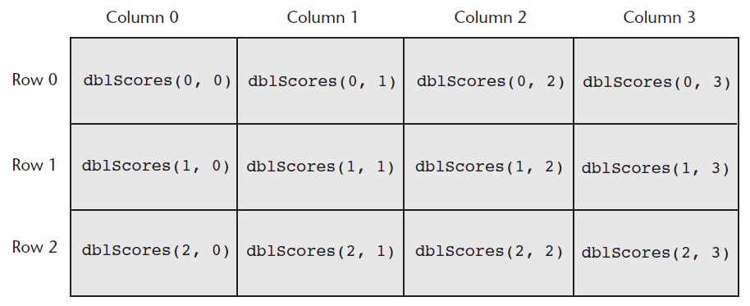
Processing Data in Two-Dimensional Arrays (1 of 3)
Use named constants to specify the upper subscripts

Slide 48
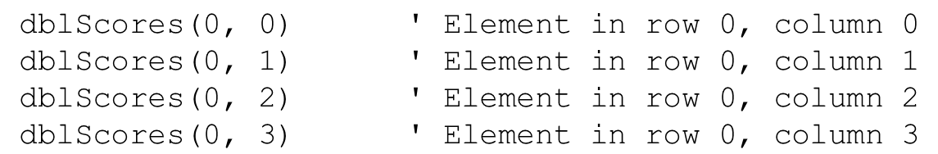
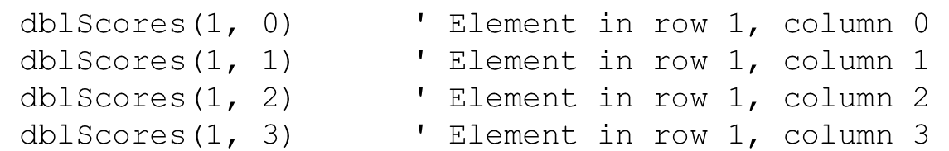
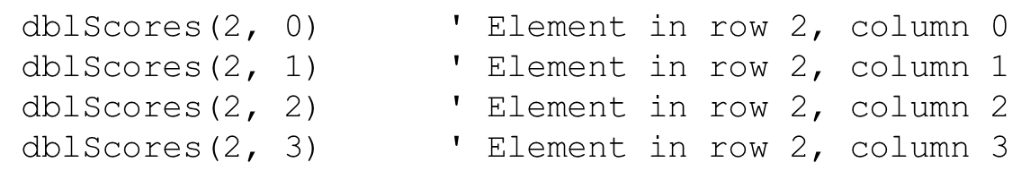
Processing Data in Two-Dimensional Arrays (2 of 3)
The elements in row 0 are referenced as follows:
The elements in row 1 are referenced as follows:
The elements in row 2 are referenced as follows:

Slide 49

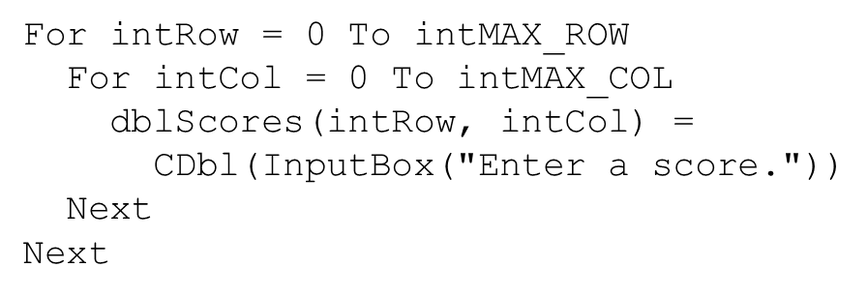
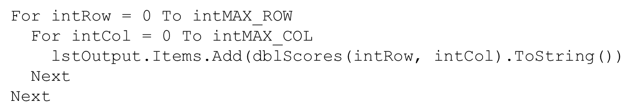
Processing Data in Two-Dimensional Arrays (3 of 3)
Example of storing a number in a single element
Example of prompting the user for input, once for each element
Example of displaying all of the elements in the array

Slide 50
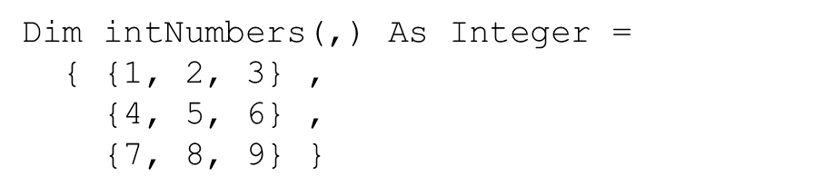
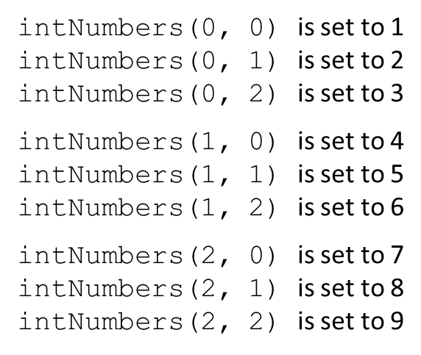
Implicit Sizing and Initialization of Two-Dimensional Arrays
When providing an initialization list for a two-dimensional array, keep in mind that:
You cannot provide the upper subscript numbers
You must provide a comma to indicate the number of dimensions
Values for each row are enclosed in their own set of braces
This statement declares an array with three rows and three columns:

Slide 51
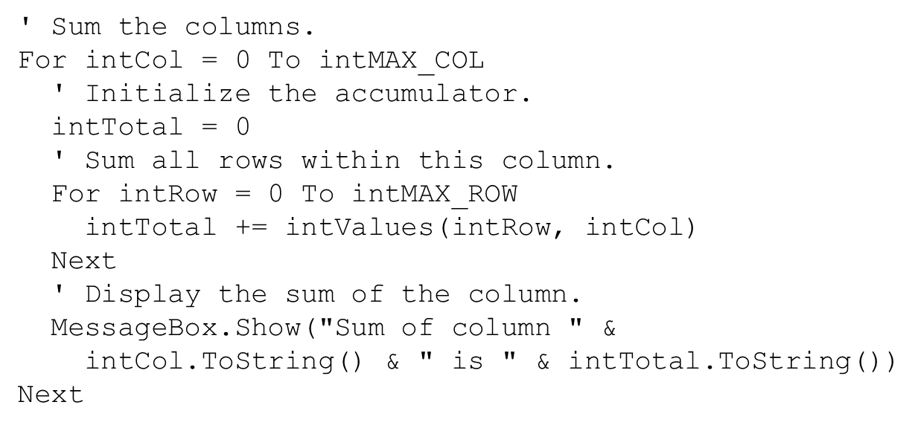
Summing the Columns of a Two-Dimensional Array
The outer loop controls the i n t C o l subscript
The inner loop controls the i n t Row subscript
Tutorial 8-6 uses a two-dimensional array in the Seating Chart application

Slide 52

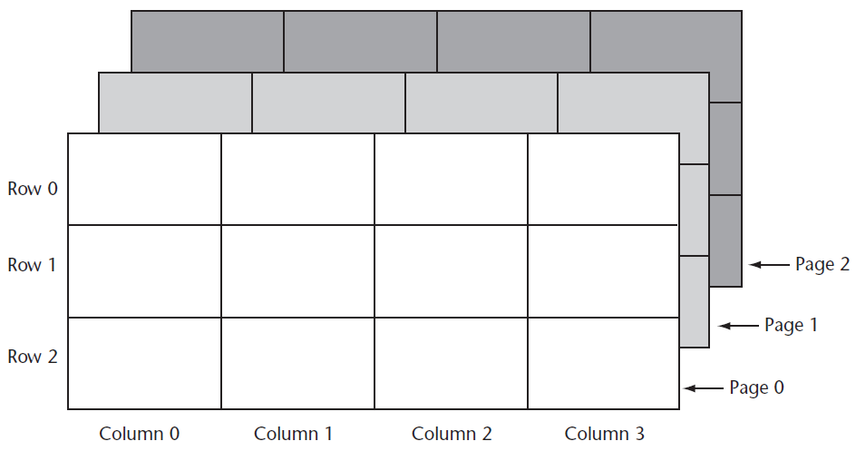
Three-Dimensional Arrays and Beyond (1 of 2)
You can create arrays with up to 32 dimensions
The following is an example of a three-dimensional array:

Slide 53
Three-Dimensional Arrays and Beyond (2 of 2)
Arrays with more than three dimension are difficult to visualize
Useful in some programming applications
For example:
A factory warehouse where cases of widgets are stacked on pallets, an array of four dimensions can store a part number for each widget
The four subscripts of each element can store:
Pallet number
Case number
Row number
Column number
A five dimensional array could be used for multiple warehouses

Slide 54
8.5 Focus on G U I Design: The Enabled Property and the Timer Control

Slide 55

The Enabled Property
Most controls have an Enabled property
If this Boolean property is set to False the control is disabled meaning the control:
Cannot receive the focus
Cannot respond to user generated events
Will appear dimmed, or grayed out
Default value for this property is True
May be set in code when needed as shown:

Slide 56
The Timer Control
The Timer control allows an application to automatically execute code at regular intervals
To place a Timer control on a form:
Double-click the Timer icon in Components section of the Toolbox
Appears in the component tray at design time
Prefix a Timer control’s name with t m r
To create a Tick event handler code template:
Double-click a Timer control that has been added to the Component tray
Code will be executed at regular intervals

Slide 57
Timer Control Properties
Timer control has two important properties:
The Enabled property
Must be set to True to respond to Tick events
The Interval property
The number of milliseconds that elapse between events
Tutorial 8-7 demonstrates the Timer control
In Tutorial 8-8 you will use the Timer control to create the Catch Me game application

Slide 58
8.6 Focus on G U I Design: Anchoring and Docking Controls

Slide 59


The Anchor Property
The Anchor property allows you to anchor the control to one or more edges of a form
Controls are anchored to the top and left edges of the form by default

Slide 60

The Dock Property
The Dock property docks a control against a form’s edge
Buttons are automatically sized to fill up in edge which they are docked

Slide 61
8.7 Focus on Problem Solving: Building the Demetris Leadership Center Application

Slide 62

Sketch of the Application’s Form

Slide 63


The Menu System
Menu Item Name | Text | Shortcut Key
m n u File | &File | blank
m n u FileExit | E&xit | C t r l plus Q
m n u Report | &Report | blank
m n u ReportData | &Enter Sales Data | C t r l plus E
m n u ReportDisplay | &Display Sales Report | C t r l plus D
m n u Help | &Help | blank
m n u HelpAbout | &About | blank

Slide 64
Class-Level Declarations
Name | Description
I n t MAX_SUBSCRIPT | A constant, set to 8, holding the upper subscript of the class-level arrays, and the upper limit of counters used in loops that process information in the arrays
s t r P r o d Names | An array of strings; this array holds the names of the D L C products
strDesc | An array of strings; this array holds the descriptions of the D L C products
i n t P r o d N u m s | An array of integers; this array holds the product numbers of the D L C Products
d e c Prices | An array of Decimal variables; this array holds the prices of the D L C Products
i n t UnitsSold | An array of integers; this array holds the number of units sold for each of the D L C products

Slide 65
Methods
Method | Description
InitArrays | Procedure; assigns the names, descriptions, product numbers, and unit prices of the D L C products to the class-level arrays
m n u FileExit_Click | Ends the application
m n u ReportData_Click | Prompts the user for sales data
m n u ReportDisplay_Click | Calculates and displays the revenue for each product and the total revenue
m n u HelpAbout_Click | Displays an About box
Form1_Load | Calls the InitArrays procedure

Slide 66

Sales Report Displayed

Slide 67
8.8 Using Lists to Hold Information (Optional Topic)

Slide 68
The List Data Type
In Visual Basic you can use the List data type to hold a set of items
Similar to an array, but has advantages
Can grow dynamically
Item removal is easy
Has a built-in searching function
The Items property of the ListBox control contains a List
The Add, Remove, and Clear methods belong to the List

Slide 69



Declaring List Variables
When declaring a List variable:
Specify the type of data the list will store
Use the new keyword to create the List object
A List can be declared and created with a single statement
A List always contains a single data type

Slide 70


Choosing Identifier Names
When naming list variables, you may optionally begin the variable name with a prefix
Using the l s t prefix, for example
l s t is also used for ListBox controls
Try using the data type prefix along with a plural noun

Slide 71





Common List Operations
The Add method adds an item to a list
The Remove method removes an item from the list
The Clear method removes all items from the list
The Count method returns the size of a list
Use an index to access any existing item in the list
Replace an item in the list by using a subscript
Tutorial 8-10 demonstrates building a list of names

Slide 72

Accessing a List with a Subscript
Using a For-Each loop to process all the elements in a list is a very easy technique
Sometimes you will want to use a loop counter to do the same thing
For example:

Slide 73

Searching for Items in a List (1 of 2)
Using the IndexOf method is an easy way to search for an item in a List
The IndexOf method:
Accepts a value as an argument
Returns the index if the value is found
Returns −1 if the value is not found

Slide 74
Searching for Items in a List (2 of 2)
There are two additional versions of the IndexOf method
Allow you to specify the area of the List that should be searched
Invalid indices will cause an exception to occur
In this version, you specify a search value and a starting index
In this version, you specify a search value along with the starting and ending indices for the range in which you want search
The IndexOf method performs a sequential search, so you may notice a slight delay when performing searches with very large lists

Slide 75

Copyright

